Slide 1
Uncertainty Estimation in Prediction
Liu Liu, UT Austin

Slide 2
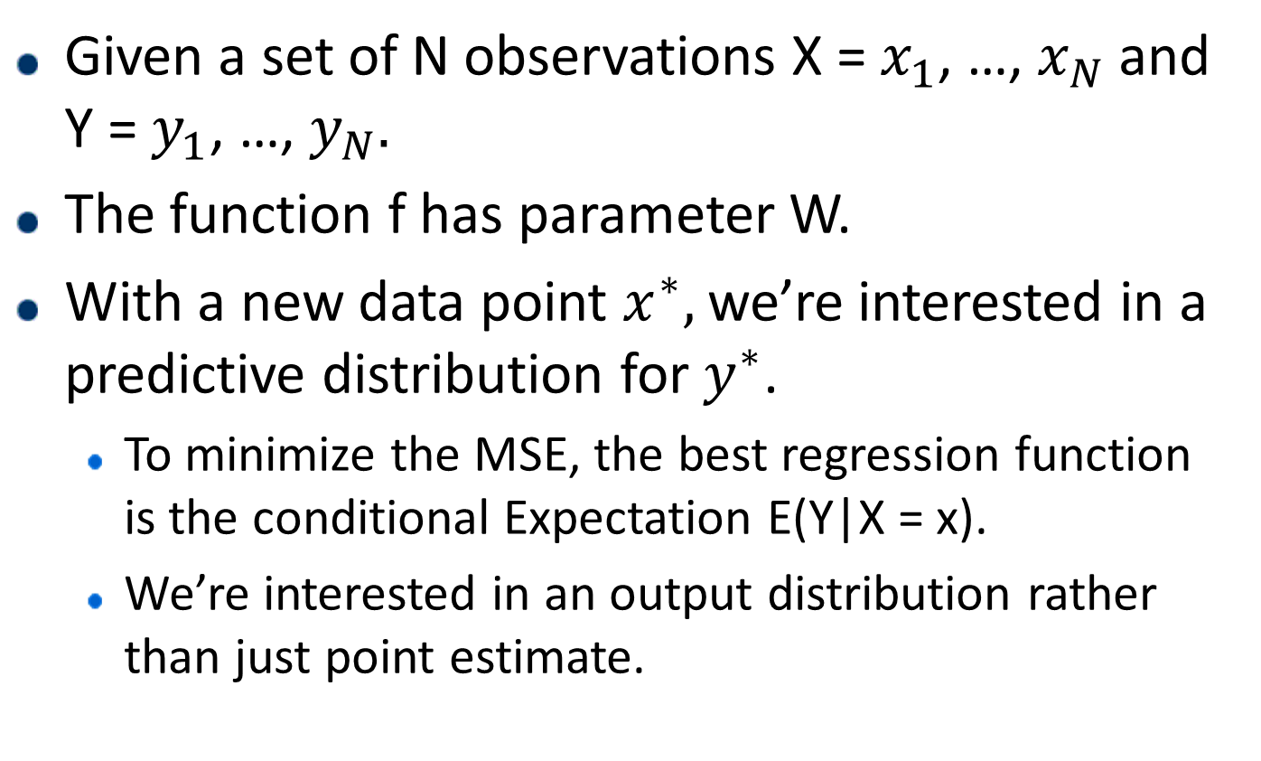
Predictive Uncertainty
Given a set of N observations X = $x_{1}$, …, $x_{N}$ and Y = $y_{1}$, …, $y_{N}.$
The function f has parameter W.
With a new data point $x^{∗},$we’re interested in a predictive distribution for $y^{∗}$.
To minimize the MSE, the best regression function is the conditional Expectation E(Y|X = x).
We’re interested in an output distribution rather than just point estimate.

Slide 3
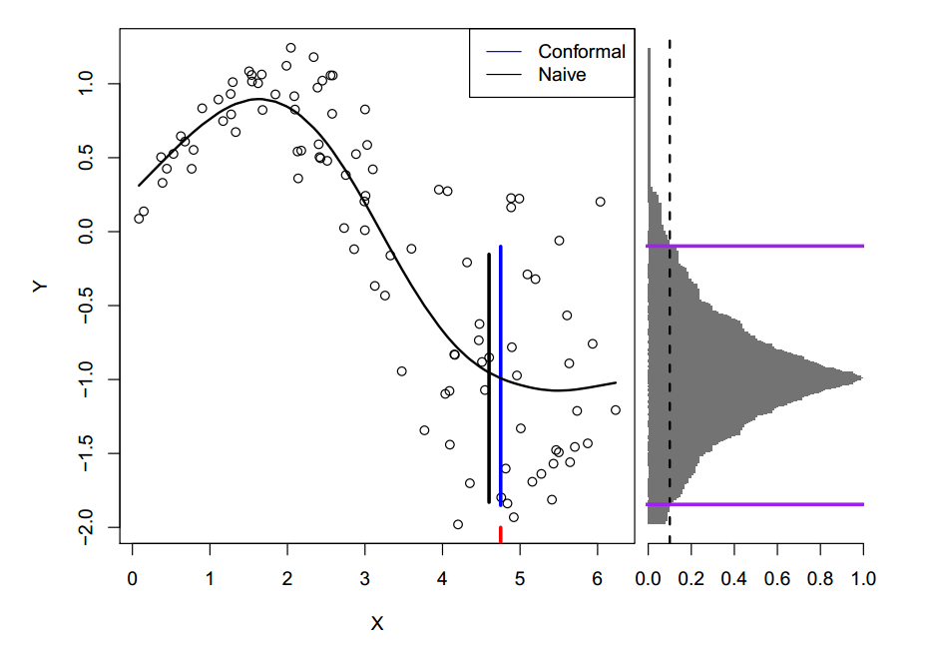
A regression example

Slide 4
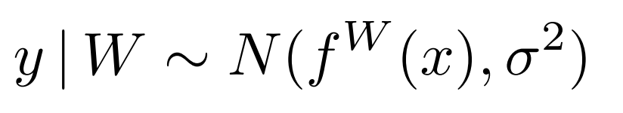
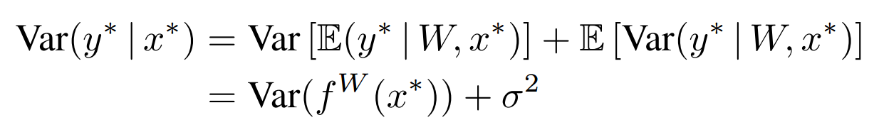
Law of total variance
Beyond conditional Expectation, we look at the variance in a (homoscedastic) regression model
By law of total variance, we have
Note that the above is not rigorous…

Slide 5
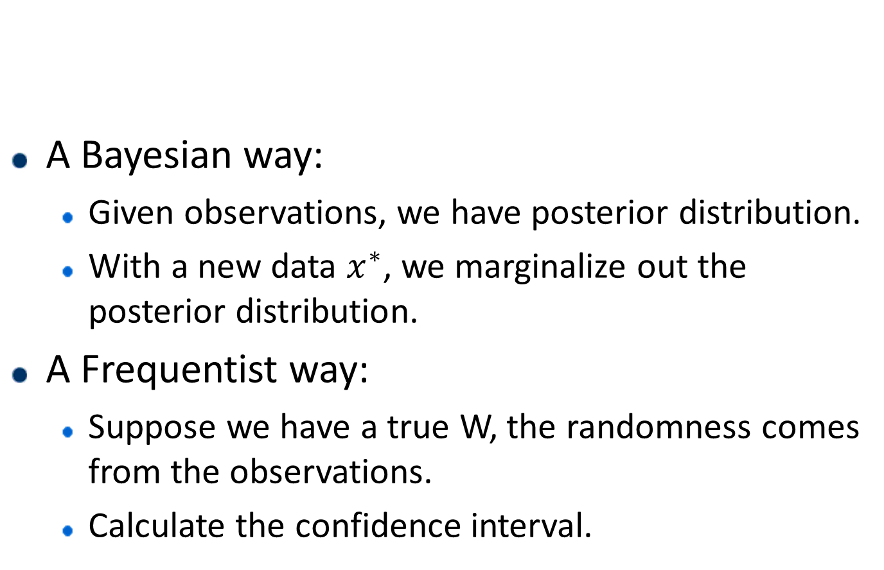
Where’s the randomness
A Bayesian way:
Given observations, we have posterior distribution.
With a new data $x^{∗}$, we marginalize out the posterior distribution.
A Frequentist way:
Suppose we have a true W, the randomness comes from the observations.
Calculate the confidence interval.

Slide 6
Dive into the decomposition
The first term is the model uncertainty.
Aka, epistemic uncertainty.
Multiple possible parameters given the observation.
Vanishes in the limit of infinite data.
The second term is the inherent noise.
Aka, aleatoric uncertainty.
Similar to boundary condition in classification.
This is irreducible, even in the limit of infinite data.

Slide 7
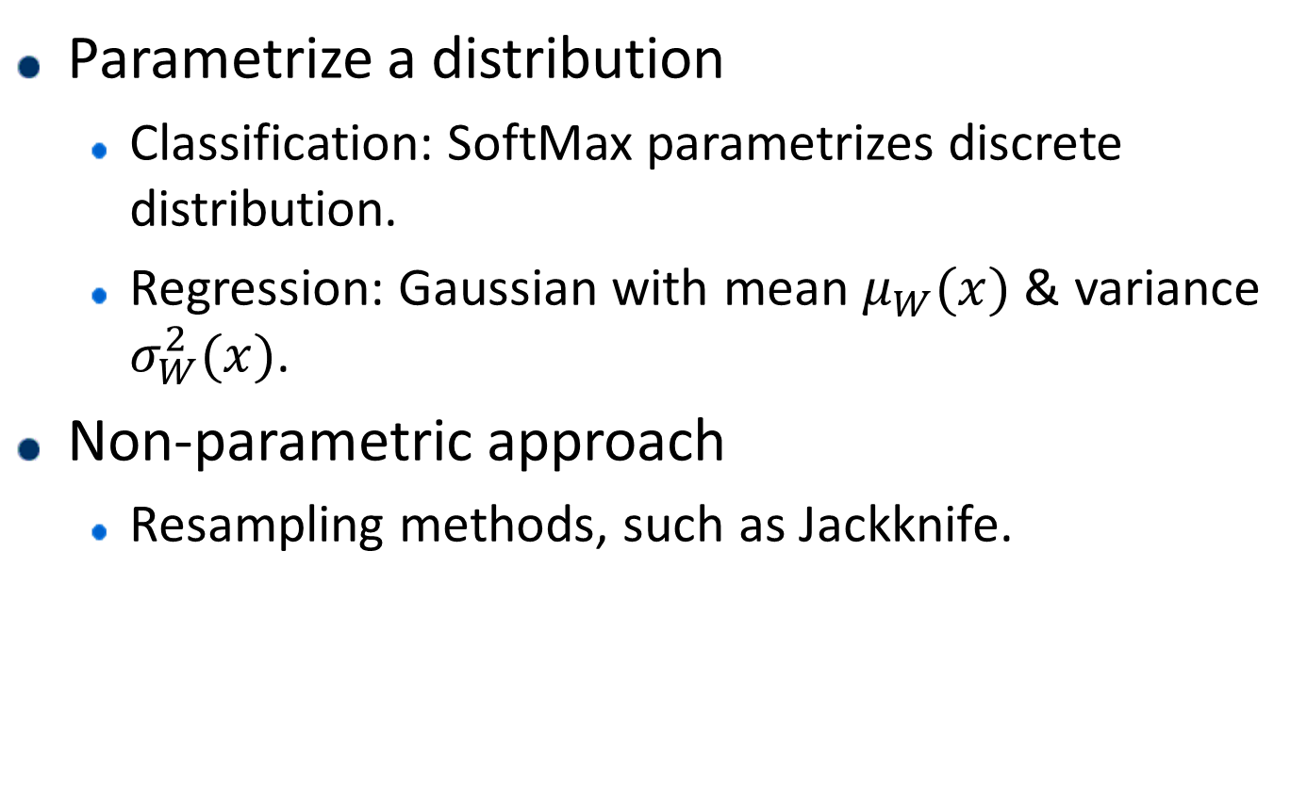
Dealing with the Inherent Noise
Parametrize a distribution
Classification: SoftMax parametrizes discrete distribution.
Regression: Gaussian with mean $μ_{W}(x)$ & variance $σ_{W}^{2}(x)$.
Non-parametric approach
Resampling methods, such as Jackknife.

Slide 8
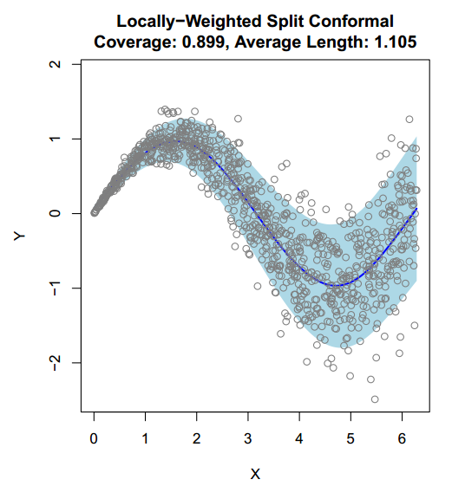
Dealing with the Inherent Noise

Slide 9
Dealing with the Model Uncertainty
Large Sample Approximations
Under some regularity conditions, MLE is asymptotically normal.
Bootstrap Confidence Interval
Draw a bootstrap sample, and estimate.
Repeat the previous step, B times.
For Deep NN, train an ensemble of M networks with random initialization…
Simple and scalable predictive uncertainty estimation using deep ensembles, NIPS 17.

Slide 10
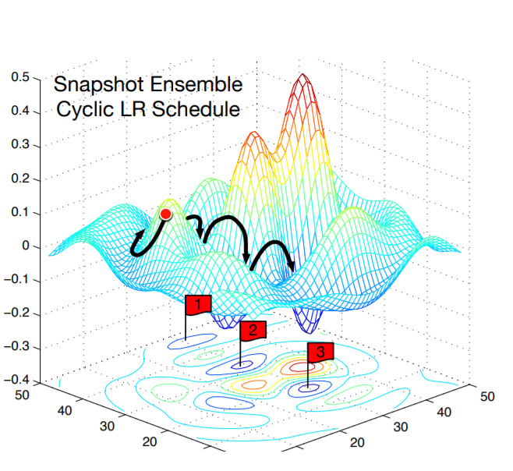
SGD inference
Using SGD iterates to construct confidence interval.
Statistical inference using SGD, AAAI 2018.
Deep Learning ensembles in one trajectory.
Snapshot Ensembles: Train 1, get M for free, ICLR 2017.

Slide 11
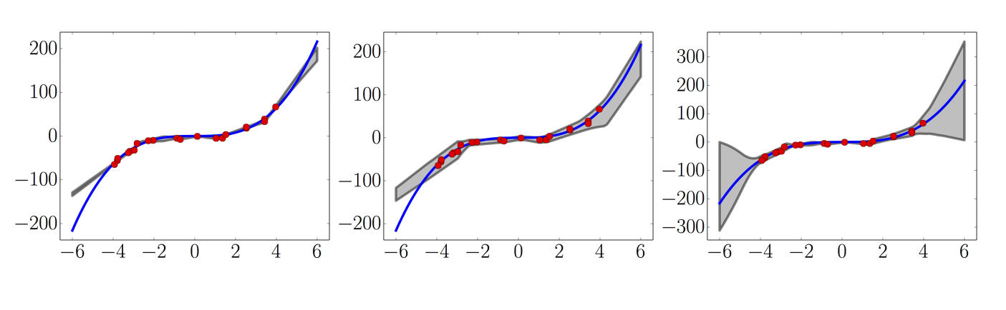
Illustrative examples
Left: non-probabilistic regression.
Middle: single probabilistic regression.
Right: ensemble of 5 probabilistic regression.

